Slide 1
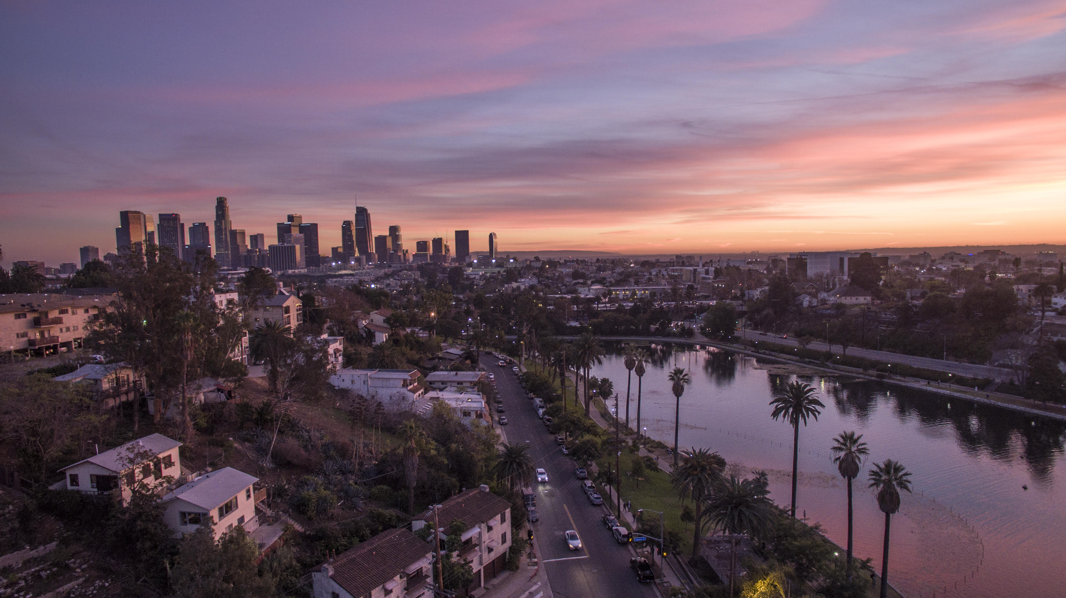
Understanding Crime Trends in Los Angeles through 911 Call
ABHINAV ADHIKARI, SATHISH REEDY KALLU, VIKAS KUMAR REDDY, MD TAHIDUL ISLAM

Slide 2
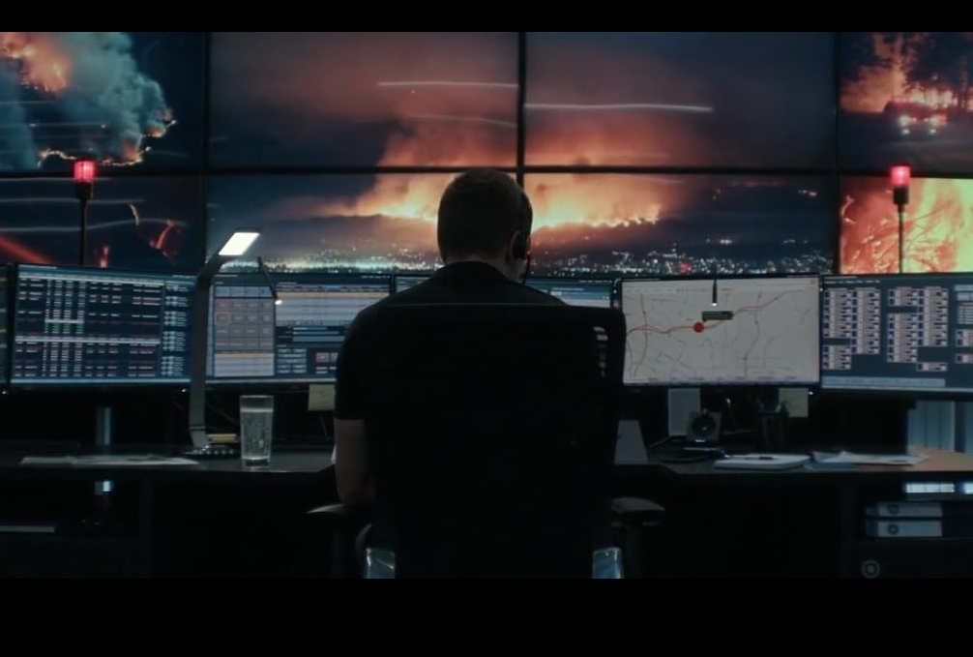
Agenda
Introduction Understanding The Data
Data Cleaning
Analyzing
Exploring
Conclusion & Future Possibilities

Slide 3

.

Slide 4

Let’s Understand the Data
Data Source: Crime data obtained from data.gov.
Scope: Analysis conducted on crime data spanning 2020 – Present.
Data Overview:
Number of Records: 815882
Variables Included: Crime Types, Locations, Time stamps, Victims, Race
Data Quality Check:
Data Cleaning Steps: Renaming Columns, Replacing Abbreviations, Standardizing names
Data Formatting: Regex, Date Time Formatting

Slide 5
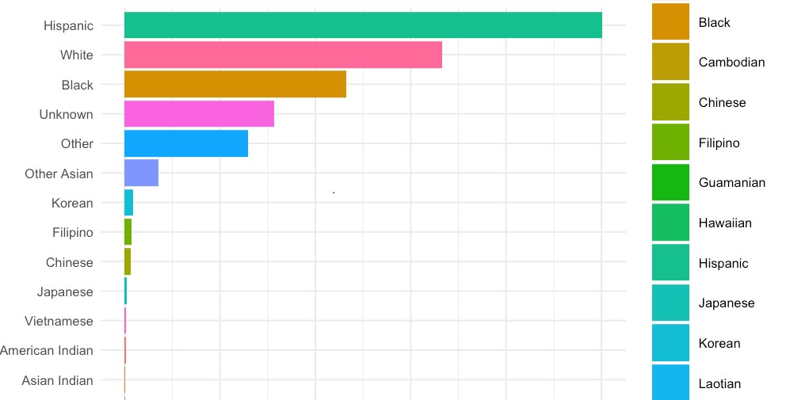
Victims BY Race

Slide 6
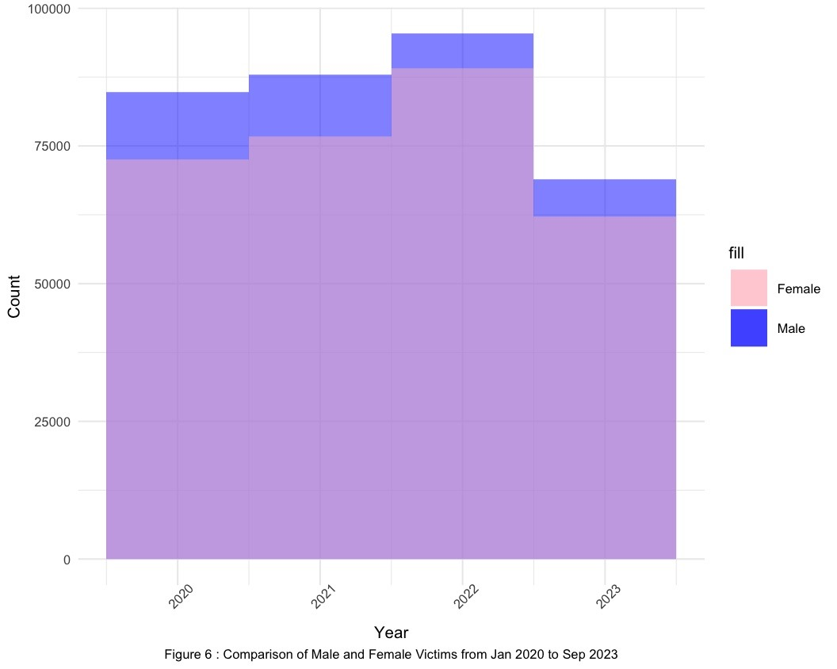
Victims BY Gender

Slide 7
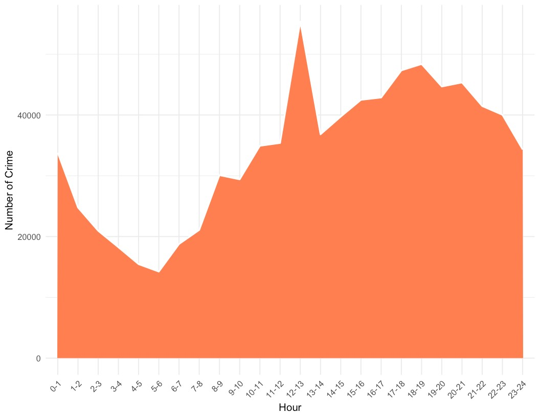
Hour of crime

Slide 8
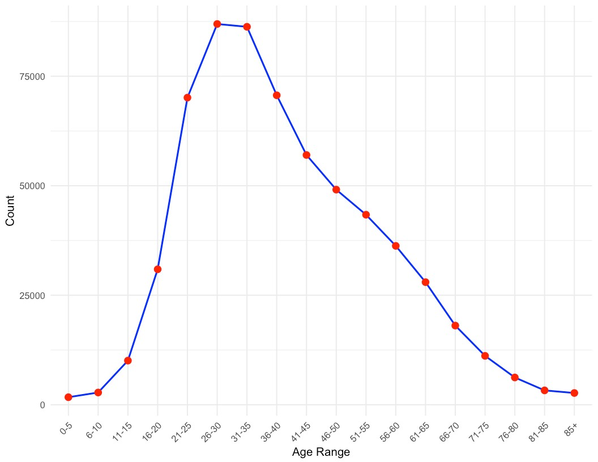
Crime Curve by Age Range
8

Slide 9
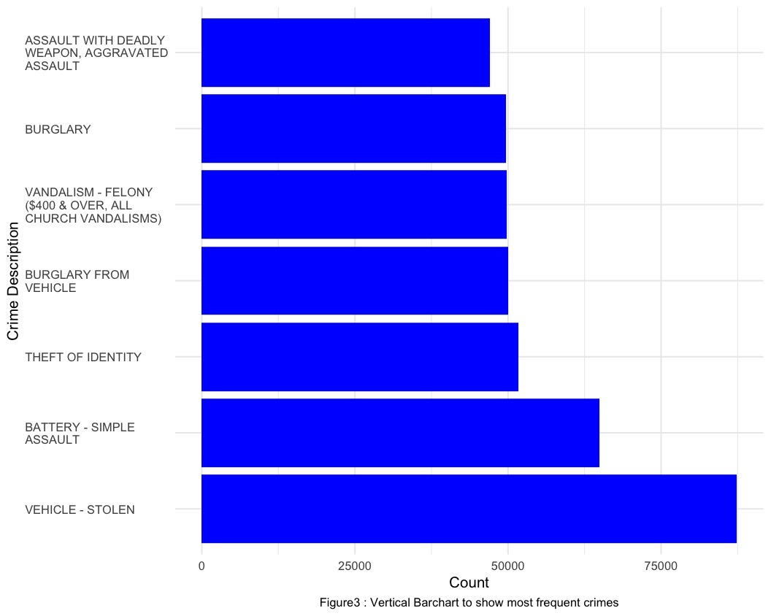
Crime Description

Slide 10
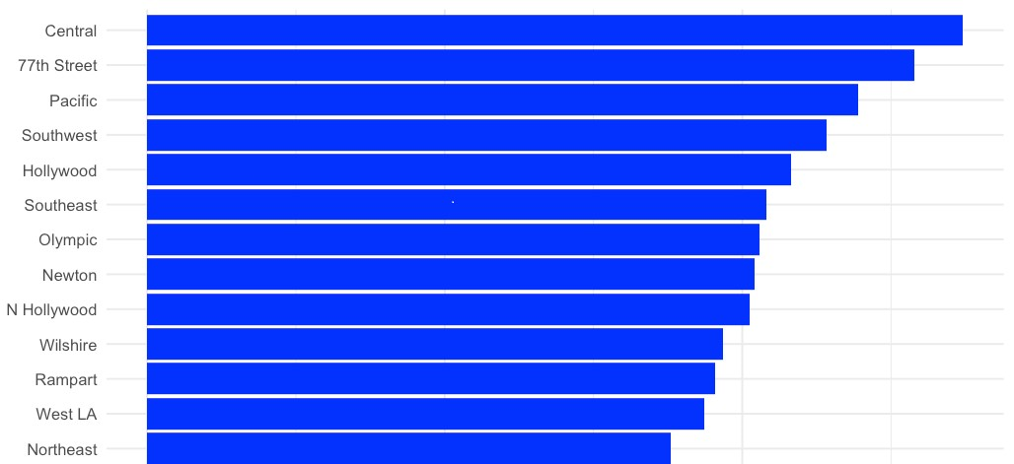
Crime Area
10

Slide 11

Summary
The exploration into Los Angeles' crime data has been an enriching and enlightening journey. Through understanding, cleaning, analyzing, and visualizing the data, we've unlocked valuable insights. The interactive map built with Leaflet stands as a testament to the power of data visualization in unraveling complex information. This map helps anyone become a detective, spotting problem areas, seeing patterns over time, and comparing different parts of LA.

Slide 12


Q&A?

